Slide 2
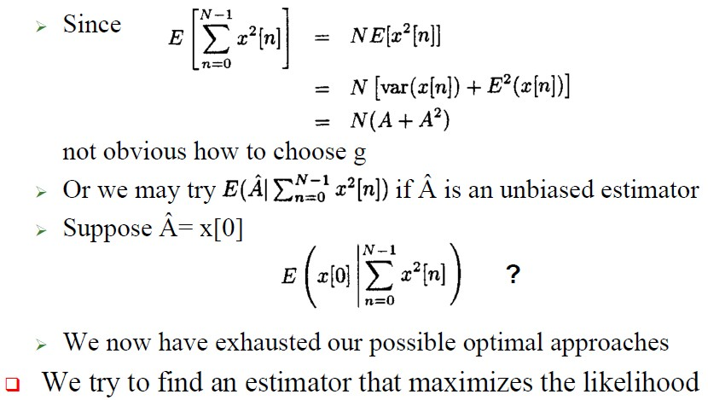
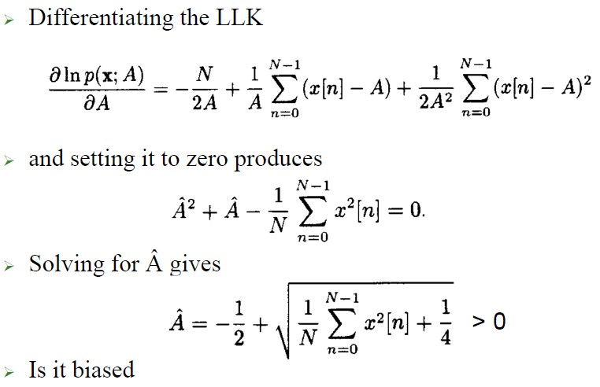
3rd Year
Detection and Estimation Theory
Dept. of Communications Eng.

Slide 3
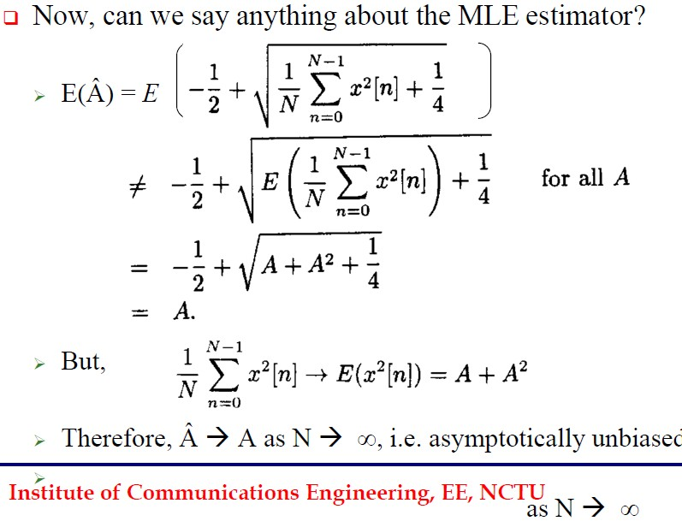
3rd Year
Detection and Estimation Theory
Dept. of Communications Eng.

